Slide 1

Los Angeles City Crime Analysis
Naga Jyothi Kunaparaju

Slide 2
Data
Dataset for this project is collected from: https://catalog.data.gov/dataset/crimes-2012-2015.
Dataset consists of 760,000 rows and 15 Attributes, including: Timeocc, Area, CrmCd, CrmCdDesc, Status, Location, CrossStreet, Lat, Long, DateRptd, Dateocc

Slide 3
Method
Pandas and Pyplot Libraries are used to create plots
In raw dataset, Lat & long combined into single column. For Geographical representation, it has been split into two columns.
Data set is also loaded into Excel, Tableau for cleansing and formatting.
Crime Dataset is maintained by LAPD.

Slide 4
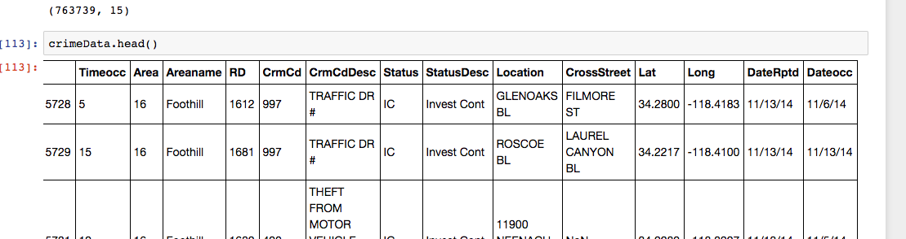
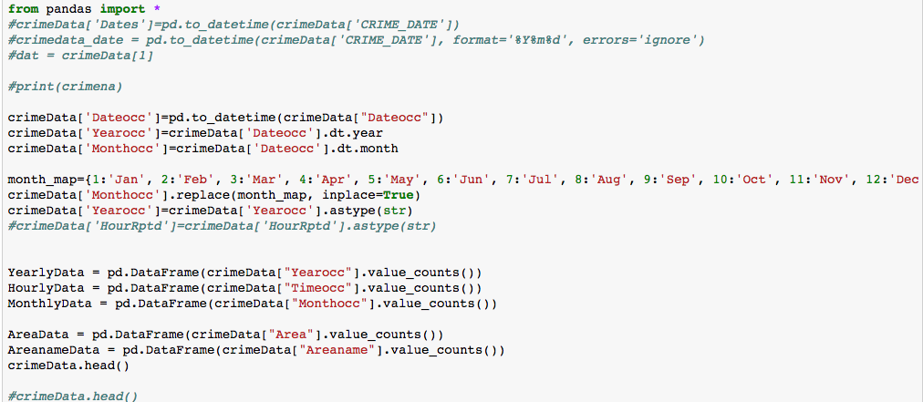

Slide 5
Method contd...
This data is divided into multiple datasets, for example:
Time variant such as Daily, Monthly, Hourly
Geographical information split into area and location.
List of Violent crimes with crime codes 1 to 8 are separated into a different dataset for analysis.
Plots are drawn with this data using Pyplots and plotly

Slide 6
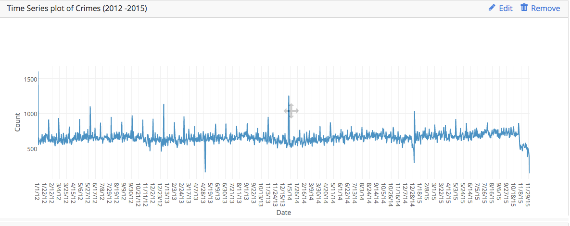
Timeseries Plot 2012-2015 https://plot.ly/~nkunaparaju/13/
Notes:
Time series from 2012 -2015. Close observation might yield some patterns.

Slide 7
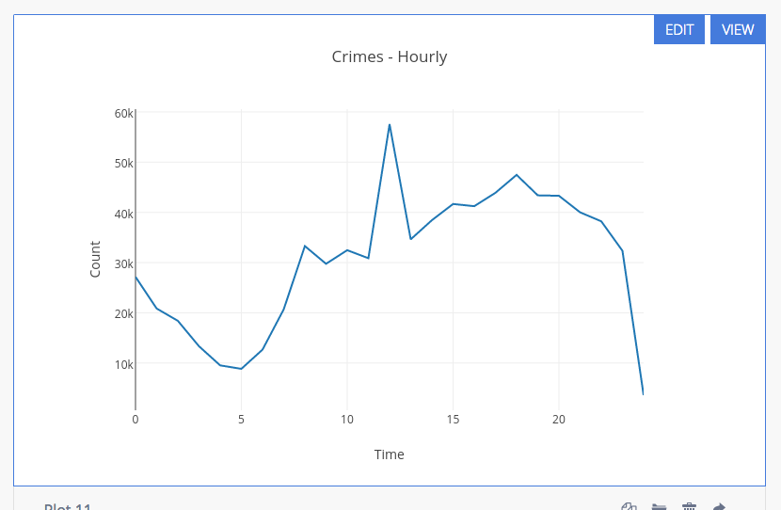
Hourly total 2012 -2015 - https://plot.ly/~nkunaparaju/11/

Slide 8
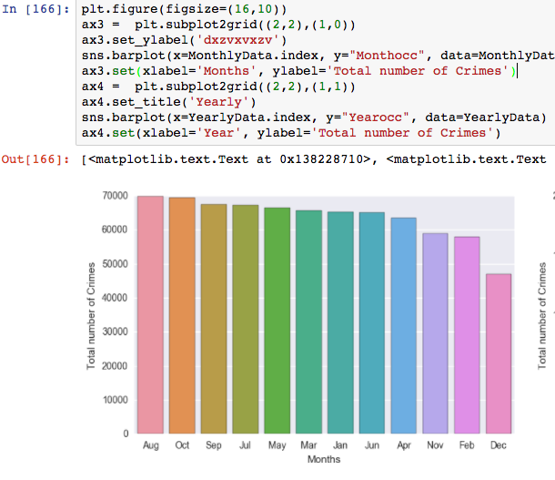
Total number of crimes: Monthly

Slide 9
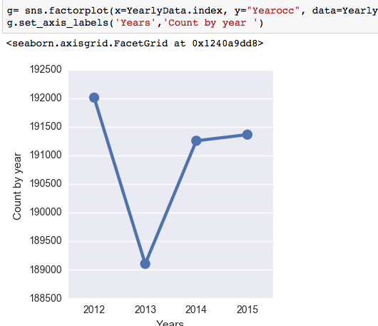
Total number of crimes for each year

Slide 10
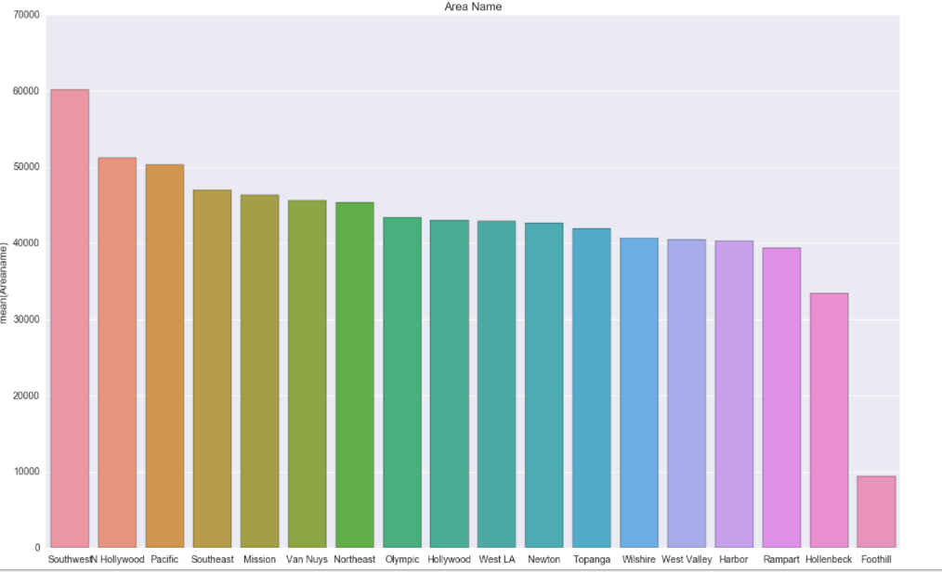
Total Crime Count by Area
Notes:
Crimes are highest in Southwest followed by Hollywood and Pacific

Slide 11
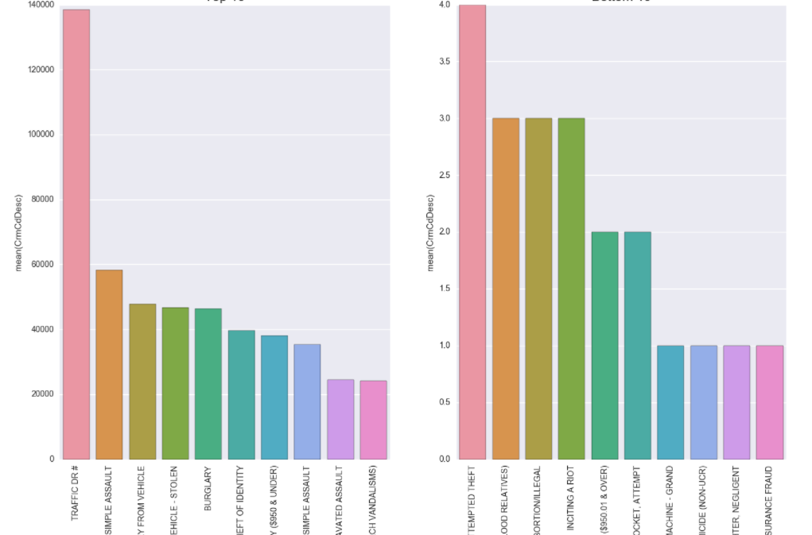
Top 10 crimes types
Least 10 crime types
Notes:
Most frequently occurring crimes are traffic related

Slide 12
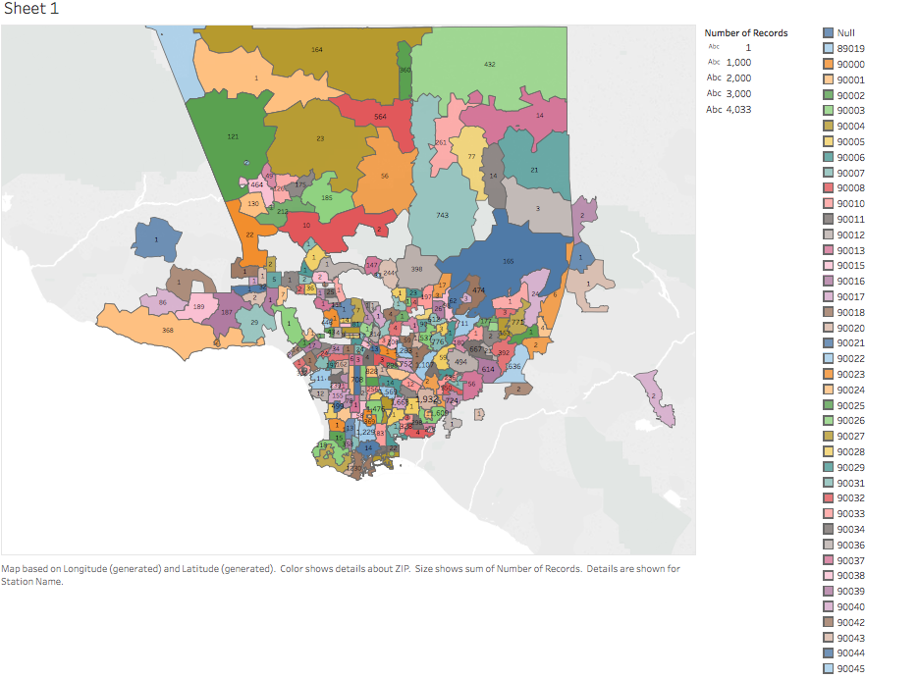
Violent crimes by Zipcode
Most violent crimes are
Criminal Homicide
Forcible Rape
Robbery
Aggravated Assault
Burglary
Larceny Theft
Grand Theft Auto
Arson
Notes:
Violent crimes by Zip code

Slide 13
Conclusions By each Plot
Daily : Every day on average around 100 to150 crimes happen in LA.
Hourly : By observing Hourly plot, Peak is around 12 pm. Afternoon, there are more number crimes compared to early hours of the day
Monthly : Monthly plot shows crime rate higher in August
Yearly : There is reduction in crimes in 2013 relative to rest of the years.
Area : Southwest area, where most criminal activity happening
Crime Type : Among all crime types Traffic related issues are higher

Slide 14
We see that Southwest area of L.A. has the highest crime in terms of the number of crimes committed. However, a bulk of the crimes committed are minor offences. Further analysis is required to draw final conclusions on which area is the more violence affected area.

